Slide 1

ART INTEGRATED PROJECT
TYPES OF SORTING IN PYTHON
By:-- PONNURI ANIRUDDHA
CLASS:- XII_S1

Slide 2
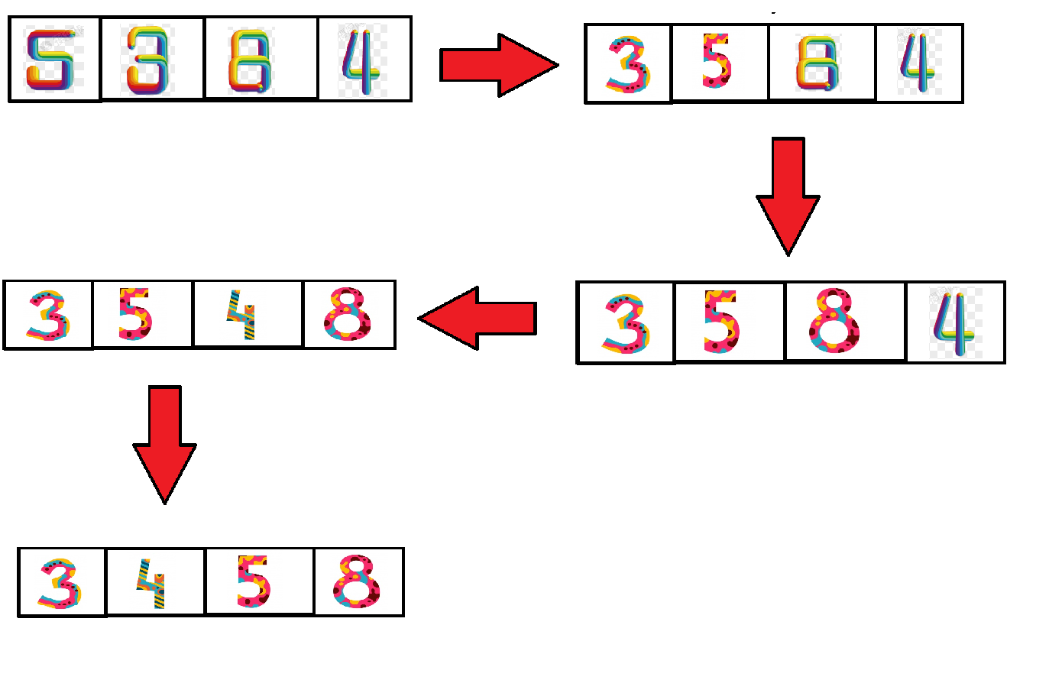
BUBBLE SORT

Slide 3
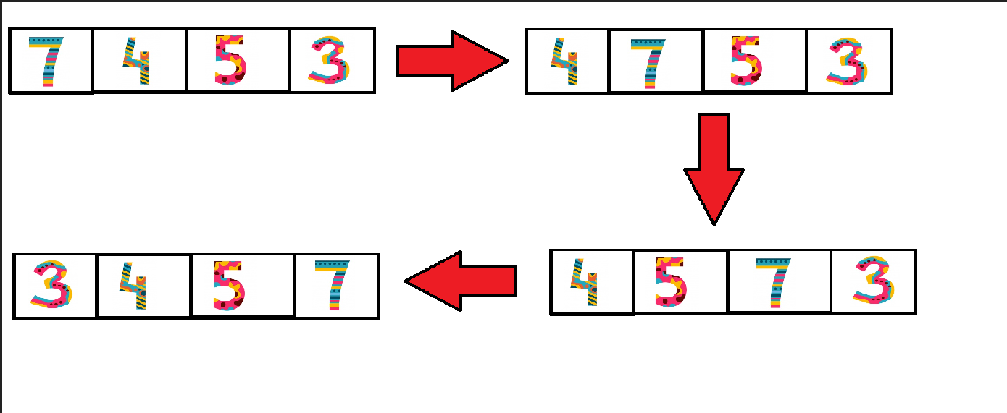
INSERTION SORT

Slide 4
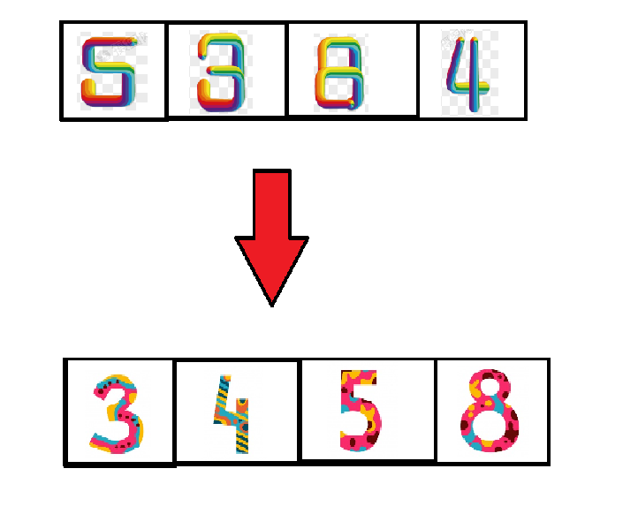
Sorted list

